Slide 1


CLOUD DATA CENTER PERFORMANCE ANALYSIS
Presented by: D v sai kumar
Registration No.: 192372321
Course code: CSA1520
Course Name: Cloud computing and Big data analytics
Date:

Slide 2
Introduction
Definition of Cloud Data Centers facilities that provide scalable computing resources over the internet.
Importance of Performance Analysis ensures efficiency, reliability, and cost-effectiveness.
Key Performance Metrics resource utilization, latency, network efficiency, energy consumption, and cost.
Impact on Businesses & Users affects service quality (QoS), uptime, and operational expenses
Challenges in Performance Optimization load balancing, hardware failures, and energy efficiency.
Objective of the Study to identify performance bottlenecks and suggest optimization strategies.

Slide 3
Objectives
Evaluate Resource Utilization assess CPU, memory, and storage usage to optimize efficiency.
Analyze Latency and Response Time identify delays in data processing and network transmission.
Monitor Network Performance ensure optimal bandwidth allocation and minimize congestion.
Assess Energy Efficiency study power consumption to reduce operational costs and environmental impact.
Identify Performance Bottlenecks detect and address issues affecting overall cloud performance.
Improve Load Balancing Strategies ptimize workload distribution for better system stability.

Slide 4
Literature Review / Background
Evolution of Cloud Computing – Transition from traditional data centers to scalable cloud-based infrastructures.
Key Performance Metrics – Focus on resource utilization, latency, energy efficiency, and cost optimization.
Load Balancing Challenges – Need for efficient algorithms to distribute workloads dynamically.
Security & Compliance – Concerns about data privacy, breaches, and regulatory requirements.
Optimization Techniques – Use of AI, edge computing, and hybrid cloud strategies for better performance.
Research Gaps – Need for advanced automation, sustainability, and real-time monitoring solutions.

Slide 5
Methodology
Research Approach – Quantitative analysis and comparison of cloud performance metrics.
Data Collection – Logs from cloud providers, simulation tools (CloudSim, iCanCloud), and real-time monitoring.
Performance Metrics – Evaluating CPU/memory utilization, latency, energy consumption, and cost.
Experimental Setup – Simulated cloud environment, workload distribution analysis, and stress testing.
Data Analysis – Statistical techniques, machine learning models, and comparative evaluation.
Validation & Benchmarking – Comparing results with industry standards and real-world case studies.

Slide 6
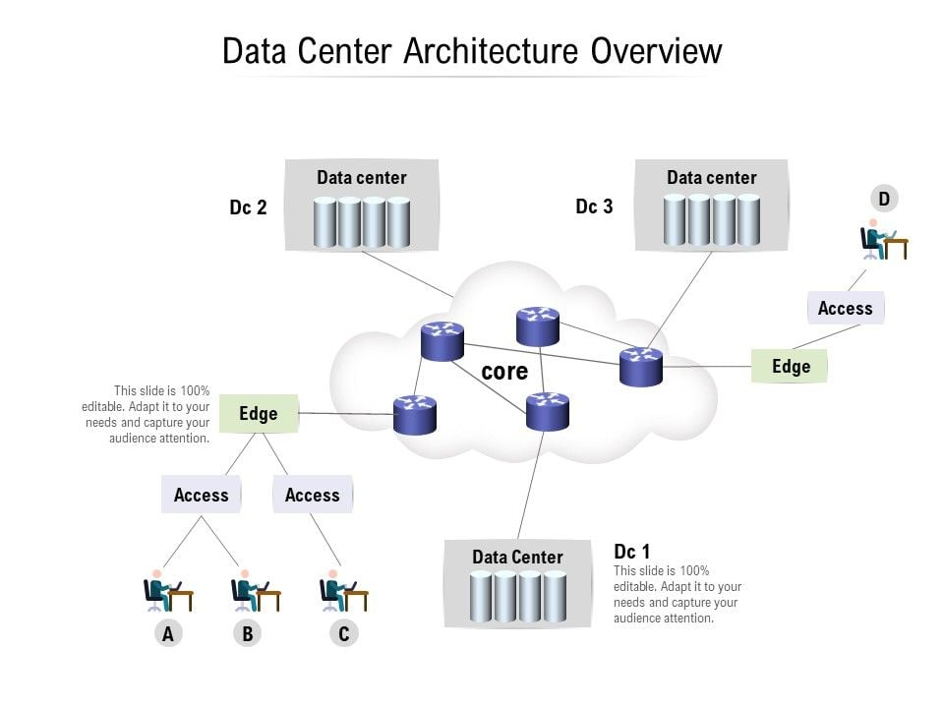
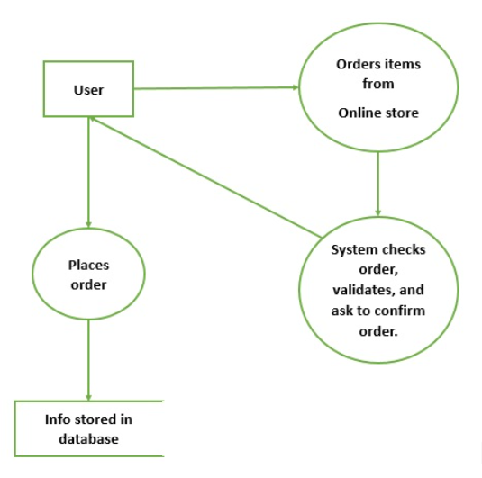
System Design / Architecture

Slide 7
Implementation
Key features and functionalities:
Load Balancing – Distributes requests using a round-robin algorithm for efficiency.
Network Performance Analysis – Measures latency and network speed.
Performance Data Visualization – Graphs CPU and memory usage trends over time.
Power Consumption Estimation – Calculates energy efficiency based on CPU utilization.
Alert System for Overload – Sends email alerts when resource usage exceeds thresholds.
Code Snippets:
import psutil
import time
def monitor_system():
print("Monitoring system performance... Press Ctrl+C to stop.\n")
while True:
cpu = psutil.cpu_percent(interval=1)
memory = psutil.virtual_memory().percent
disk = psutil.disk_usage('/').percent
print(f"CPU: {cpu}% | Memory: {memory}% | Disk: {disk}%")
time.sleep(2) # Refresh every 2 seconds
if __name__ == "__main__":
try:
monitor_system()
except KeyboardInterrupt:
print("\nMonitoring stopped.")

Slide 8
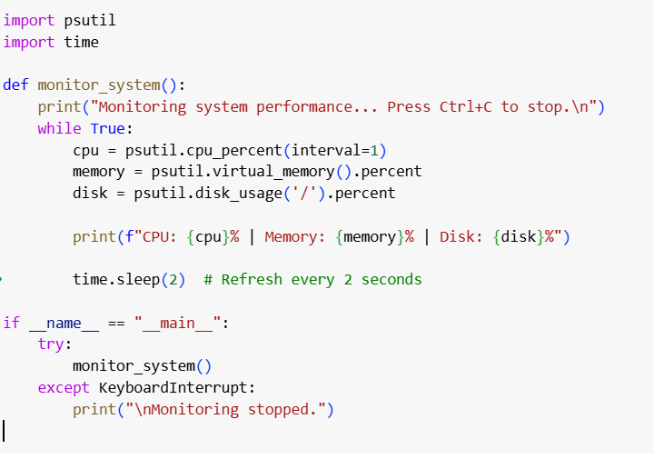
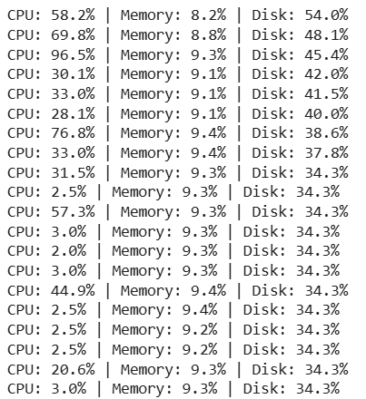
The implemented code:
Output:

Slide 9
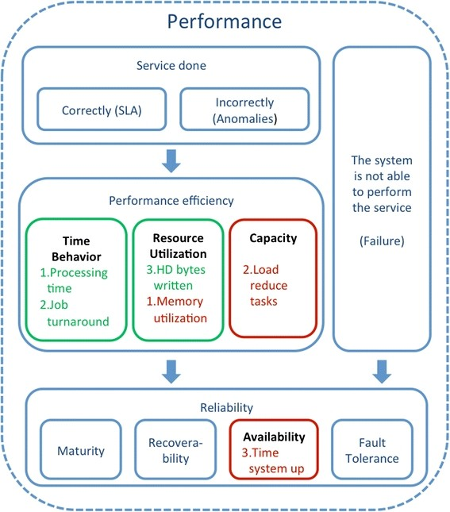
Results & Discussion
CPU Utilization – CPU usage fluctuates based on system load, peaking during heavy tasks.
Memory Usage – Memory consumption increases with active applications but remains stable otherwise.
Disk Performance – Disk usage is generally stable, with spikes during file operations.
System Performance Under Load – High CPU usage (above 80%) leads to noticeable slowdowns.
Energy Consumption – Power usage rises with increased CPU workload, affecting efficiency.
Monitoring Accuracy – Real-time monitoring provides reliable performance insights.

Slide 10
Challenges & Limitations
High Resource Consumption – Continuous monitoring can consume system resources, affecting performance.
Limited Scalability – The basic monitoring script may not handle large-scale data centers efficiently.
Lack of Historical Data – The script provides real-time monitoring but lacks historical trend analysis.
No Automated Alerts – The system does not send proactive notifications for high resource usage.
Single System Focus – Designed for a single machine, it does not support multi-server monitoring.
Limited Visualization – Data is displayed in text format without graphical insights for analysis.

Slide 11
Future Scope
Integration with Cloud Platforms – Extend monitoring to cloud-based data centers like AWS, Azure, and Google Cloud.
AI-Based Predictive Analysis – Implement machine learning models to predict performance bottlenecks and failures.
Automated Alerts & Notifications – Develop an alert system to notify administrators of high resource usage via email or SMS.
Scalability for Large Networks – Enhance the system to monitor multiple servers and virtual machines simultaneously.
Data Visualization Dashboard – Implement a web-based dashboard using tools like Grafana or Matplotlib for better insights.
Energy Optimization Strategies – Develop algorithms to reduce power consumption in data centers, improving efficiency.

Slide 12
Conclusion
Efficient Performance Monitoring – The implemented system effectively tracks CPU, memory, and disk usage in real-time.
Real-Time Insights – The script provides instant feedback on system performance, helping in proactive management.
Scalability Challenges – While useful for single-system monitoring, enhancements are needed for large-scale data centers.
Potential for Automation – Adding predictive analytics and automated alerts can improve system reliability.
Future Enhancements – Integration with cloud platforms and visualization tools can enhance usability and efficiency.
Practical Applications – This monitoring tool can be used in IT infrastructure management to prevent system failures.

Slide 13
References
Psutil Documentation – System and process utilities for monitoring CPU, memory, and disk usage.
https://psutil.readthedocs.io/
Cloud Data Center Performance – Research papers on cloud computing and data center efficiency.
IEEE Xplore, Springer, and ACM Digital Library.
System Monitoring Best Practices – Guidelines from industry leaders like AWS, Microsoft Azure, and Google Cloud.
https://aws.amazon.com/monitoring/
https://learn.microsoft.com/en-us/azure/
Data Visualization in System Monitoring – Use of Grafana, Prometheus, and Matplotlib for better insights.
https://grafana.com/
https://matplotlib.org/
Performance Optimization Techniques – Studies on improving data center energy efficiency and resource allocation.
Various white papers and research journals on cloud computing and system optimization.

Slide 14
Thank You!
Any Questions?

